Slide 1



Understanding the role of peripheral physiology in caregiving interactions: Child maltreatment risk and response to PCIT intervention
Elizabeth A. Skowron, Ph.D.
Professor, Department of Psychology
Director, Family Biobehavioral Health Lab
University of Oregon
Email: eskowron@uoregon.edu
Penn State Child Maltreatment Solutions Network Conference: Biological Embedding of Caregiving Adversity (11/15/2024)
Notes:
Thank you’s for the invitation: Erika Lunkenheimer and conference sponsors
research was funded by the National Institutes of Health through National Institute on Drug Abuse Grant R01-DA036533

Slide 2

“Invisible” Drivers of At-Risk parenting
Maladaptive caregiving interactions
Conflicts between internal reactivity and caregiving parenting demands
Caregiver physiological responses during parenting
Dysregulation
Negative, threat-sensitive child attributions
e.g., Azar & Weinzierl, 2005; Dix, 1991; Lavi et al., 2021; Skowron & Funderburk, 2022
Notes:
TRANSITION: next slides show studies that have taught us about “Biological embeddedness of caregiving risk”
Easy to ID great/good and harsh, aversive parenting behavior when observing – we know when we see.
More difficult to see / diagnose maladaptive PATTERNS of interaction
Coercive process
Pos. parenting → response to neg/disruptive child beh
Difficult to learn or maintain desired behaviors if they are physiologically ‘triggering’
Several conceptual models suggest that a conflict between parents’ emotional dynamics and parenting demands underlies at-risk parenting, that is, parenting tasks (even low stress or ‘pleasant’ ones) leading to distress and arousal, which, due to a lack of regulatory capacity or skills, compromise the quality of parenting
Numerous studies -- CM parents are more controlling, intrusive, and hostile with their children (Wilson et al., 2008). tend to initiate fewer positive interactions, engage in more emotional distancing, withdrawing, and ignoring than non-CM parents.
However, many CM studies conducted to date fail to capture information contained within the dynamic interactive sequence influenced by both members of the dyad. Beyond study of the presence or absence of conflict for example, dyadic analysis focuses on the sequence of behaviors that unfold in response to conflict.

Slide 3


Positive Synchrony, Rupture & Repair Processes in Child Welfare Families
In the high-risk families…
Parents initiated more ruptures
Children initiated more repairs
Fewer successful returns to positive synchrony
In the lower-risk families…
Children initiated ruptures
Parents initiated more repairs
More successful repairs
NIMH R01 MH079328
Notes:
Healthy mother-child interactions are characterized by frequent cycles of positive synchrony, ruptures, and repairs (e.g., Cohn & Tronick, 1988; Harrist, Pettit, Dodge, & Bates, 1994; Tronick & Cohn, 1989). For these dyads, conflict is not absent from the interaction, but rather mother and/or child are able repair the “rupture” and resume synchronous states more quickly.
In contrast, mothers at high-risk for CM are more likely than their children to initiate ruptures while parenting, and are less likely to repair with their children than are low risk mothers (Skowron, Kozlowski, & Pincus, 2010
So this speaks to behavioral synchrony (and rupture/repair)….
But what about synchrony between behavior and physiology…in person, in dyad, in system….?

Slide 4

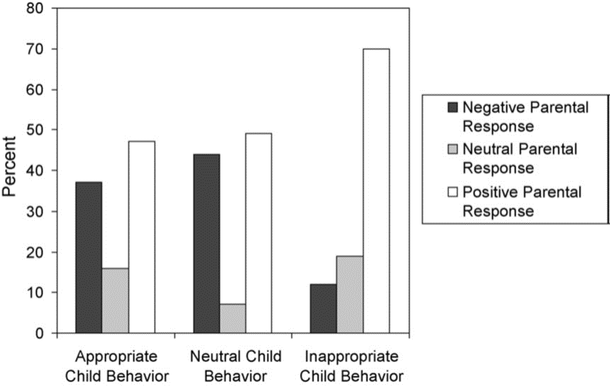

Caregiver Response Patterns in Child Welfare Families: Inconsistent/unpredictable, & reinforcing negative child behavior
Parent Response to Child
Hakman, Chaffin, Funderburk, & Silovsky, 2009

Slide 5

Parent Physiological Responses during Caregiving Interactions in Child Welfare Families
See dynamic associations in moment-to-moment physiology and caregiving-behavior?
Physiological arousal
Parenting behavior
Parent-child interactions
Notes:
Distinct patterns of PNS responding in concordance with parenting behavior – we have been studying these specifically in mothers (and to lesser extent fathers…) with a history of perpetrating CM. (Skowron et al., 2013):
This work share in slides that follow
suggests that highest risk CW parents appear to experience (increases in) positive parenting as physically taxing (physical abuse).
Body of work seems to suggest that critical differences in CM parents’ autonomic sensitivity to their own caregiving behaviors and some of their child’s behaviors that make it (more) difficult to resist harsh, controlling, or withdrawn parenting.
Studies: CW involved mothers & 3-5 year old children
During joint puzzle task: Child builds a replica 3-D block figurine; Mother asked to assist child, but do not handle the blocks; Dyadic behaviors micro-coded at the level of speaking turns using SASB; and monitored Autonomic physiology (RSA) recorded in both mother & child during task, in sequential 30-sec epochs

Slide 6
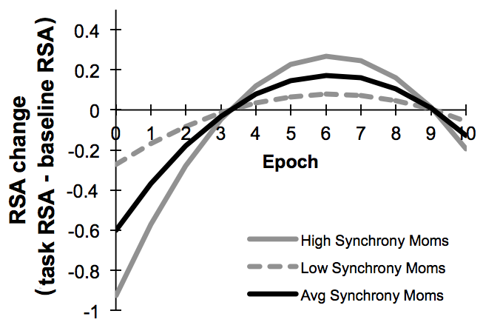


Positive Behavioral Synchrony: ↑ Dynamic Physiology
  Mothers who achieved high levels of positive synchrony with their child → most responsive psychophysiological profile
    large RSA withdrawal at task onset, followed by sharp RSA increases over time
  Mothers who achieved low levels of positive synchrony showed attenuated (less responsive) psychophysical profiles
T2
*p ≤ .06
Giuliano, Skowron, & Berkman, 2015,
Biological Psychology
Notes:
During joint puzzle task: Child builds a replica 3-D block figurine; Mother asked to assist child, but do not handle the blocks; Dyadic behaviors micro-coded at the level of speaking turns using SASB; Autonomic physiology (RSA) recorded in both mother & child during task, in sequential 30-sec epochs
Positive Dyadic Synchrony(i.e., proportion of speaking turns)
M = 0.49 (SD = 0.31)
Range = 0.00 - 1.00
Latency to Repair (i.e., number speaking-turns post-rupture until repair)
M = 8.9 speaking turns (Mdn = 6.25; SD = 8.28)
Positive skew = 3.48
Range = 2.0 to 69 speaking turns
log transformed for analyses

Slide 7



Physically abusive parents
drives
↑ Physiological Arousal
(RSA declines)
↑ Harsh, controlling
↑ Warm, responsive
Skowron, Cipriano-Essel, Benjamin, Pincus, & Van Ryzin, 2013, CFP
Notes:
Reductions in CM mother’s respiratory sinus arrhythmia (RSA) during parenting drive real-time increases in harsh parenting³
Effective CM prevention programs ➔ need to de-couple (or unhook…) maladaptive links between positive parenting and negative physiological response….enter PCIT

Slide 8

Physically neglectful parents
AND
↑ Physiological Calm
↑ Physiological Arousal
↑ Warm, responsive
↑ Harsh, controlling
Skowron, et al., 2013, CFP
Notes:
80%+ of physical abuse & neglect cases are perpetrated by parents¹
Patterns of coupling in physically neglectful mother’s respiratory sinus arrhythmia (RSA) during (-) and (+) parenting could potentiate effective interventions’ gains
TRANSITION TO CHILD EFFECTS ON PARENT PHYS FINDINGS….next slide
Child to Mother Effects : Does child behavior have an impact on mother’s parasympathetic tone during social interactions?
Effective CM prevention programs ➔ need to de-couple (or unhook…) maladaptive links between positive parenting and negative physiological response?
….enter PCIT

Slide 9
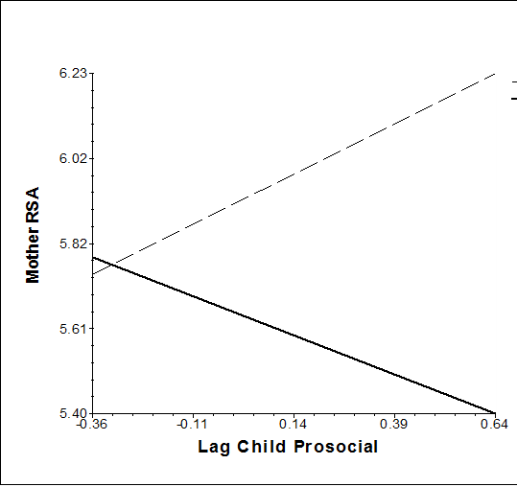


Child Trust & Rely Behavior ➔ Maternal Physiological Response
1. EMANCIPATE
Separate
Non-maltreating
8. IGNORE
Wall-Off
2. AFFIRM
Disclose
In non-maltreating:
child trusting & relying behaviors ➔ mom physiology calms (increased RSA)
In physically-abusive:
child trusting & relying behs ➔ mom gets more aroused (decreased RSA)
7. ATTACK
Recoil
3. ACTIVE LOVE
Reactive Love
Physically Abusive
6. CRITICIZE
Sulk
4. PROTECT
Trust/Rely
5. CONTROL
Submit
*p ≤ .08
*age covaried in models
Wells, Skowron, Scholtes, & DeGarmo, 2020. Dev. Psychopathol.
Notes:
few studies have examined the effect of children’s compliance behaviors on their parents. Thus, the focus of this study was to examine the evocative effects of child warm submission/ trusting & relying (compliance) behaviors on maternal autonomic physiology (i.e., RSA).
in line with Bugental and Sameroff’s biocognitive transactional models, we wondered whether CM parents, who tend to hold more ‘threatsensitive’ attributions of their children’s behavior (Bugental, 2009), would show greater physiological sensitivity to their child’s compliance behaviors than non-maltreating mothers.
KEY FINDINGS: Although no differences across the various CM and non-maltreating dyads were observed in levels of children’s prosocial compliance behaviors, nor in mothers’ dynamic RSA responses, we found that mothers in the study were differentially physiologically responsive to their children’s prosocial compliance (i.e., trusting and relying behavior) depending on whether they were physically abusive, neglecting, or non-maltreating mothers. In response to increasing prosocial compliance in their preschool-aged child, physically abusive mothers displayed patterns of RSA decreases (i.e., increasing arousal) in the next 30-second epoch, whereas non-maltreating mothers displayed patterns of RSA increases (i.e., decreasing arousal or greater calm) 30 seconds later,
INTERPS:
in non-maltreating dyads, mothers responded to their children’s bids for protection and warm guidance with subsequent increasing parasympathetic influence on heart rate, promoting physiological calm that enables and supports social coordination and engagement, which may be experienced by both interactive partners as mutually reinforcing. These findings are consistent with existing literature documenting patterns of parent RSA increases during positive interactions with their preschool children.
young children’s prosocial compliance behaviors can be considered evolutionarily adaptive because they entail following their caregiver’s lead, maintaining proximity, and seeking parent guidance. Based on our findings, these prosocial child behaviors may also serve to support caregiver homeostasis, by down-regulating and soothing mothers’ physiology in the context of connection.
In contrast, this same type of prosocial compliance behavior in children appeared to heighten arousal in their physically abusive mothers (i.e., leading to decreases in RSA in the following 30-second epoch). Thus, the highest risk mothers—those who perpetrated child physical abuse—responded to their children’s prosocial bids for warm guidance with a physiological response suggestive of arousal, effortful exertion, or distress. findings indicate that physically abusive mothers may experience their children’s age-appropriate, prosocial behavior as physiologically taxing.
our findings indicate that children’s developmentally appropriate, prosocial trusting and relying behavior elicits significant RSA declines 30s later in mothers who are documented perpetrators of child physical abuse. Social learning principles suggest that if children’s prosocial bids are not reinforced, children are likely to use other, less positive behavioral strategies to gain parents’ attention and approval (Patterson, 1992; Reid & Patterson, 1989; Wahler & Dumas, 1986). If children of abusive mothers discern that their prosocial behavior causes arousal or distress in their parent, they may learn to adopt an alternative repertoire, potentially one that involves use of more aversive behaviors. This transaction could represent a central mechanistic process that contributes over time to elevated conduct problems in maltreated children (Kim & Cicchetti, 2010). In line with this notion, Hakman and colleagues (2009) reported patterns of parental indiscriminate responding to children’s positive and neutral behaviors, and positive parent responding to negative child behaviors in physically abusive families.
METHODS:
10 30-second time samplings of child compliance behavior, mother physiology data, and inconsistent parenting collected during the problem-solving interaction task. The time series data were specified using methods outlined by Singer and Willett (2003) for entering time-ordered and time-varying covariates. That is, to better establish causal assumptions, time-varying predictors were tested concurrently over epochs and using temporally specified lagged effects and person-centered level 1 predictors. In the final stage of analyses, we tested for level 2 moderators of level 1 effects.
The sample was characterized by higher proportions of prosocial compliance behavior (M = .35) relative to aversive compliance (M = .25); still, one-quarter of all child behaviors were aversive.
main effects supported hypotheses for child prosocial compliance but were not supported for child aversive compliance. That is, controlling for CM type, greater lagged child prosocial compliance behavior was associated with higher subsequent maternal RSA (β10 = .60, p < .05). BUT, the beneficial effect of children’s lagged prosocial compliance on maternal RSA was moderated by the presence of physical abuse.

Slide 10
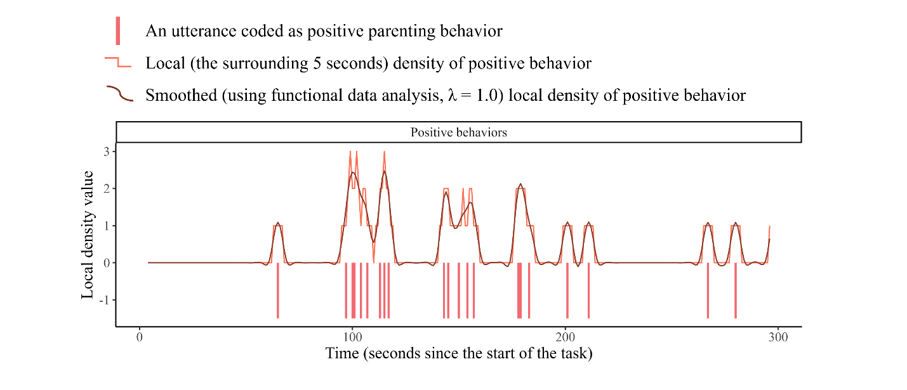

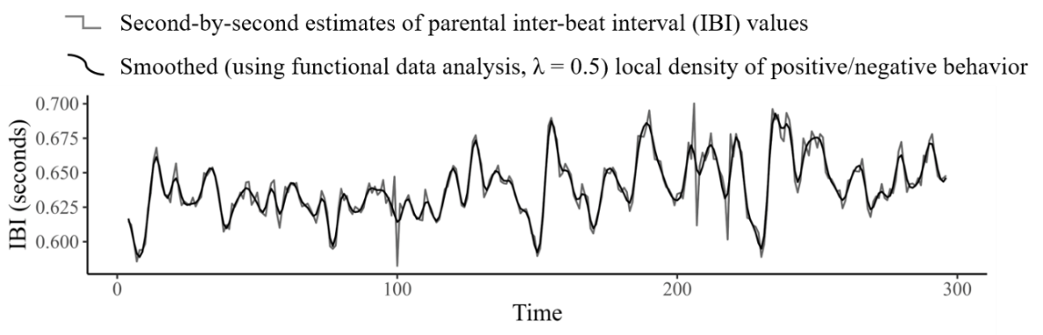
Parent Physiology during Caregiving Interactions in Child Welfare Families at Intake
Xutong Zhang, Ph.D
Notes:
New sample of CM families: Intake (T1) data from RCT study
Describe the DPICS coding data and the physiology data that we collected and analyzed…dynamic associations between parents’ IBI and the local density of positive or negative parenting behaviors.

Slide 11
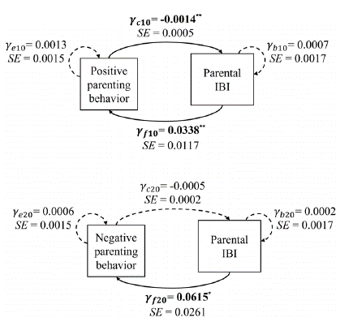
Parent Physiology during Caregiving Interactions in Child Welfare Families at Intake
Xutong Zhang, Ph.D
Zhang, Gatzke-Kopp, & Skowron (2023). D&P
Notes:
Note. Each arrow indicates that how the momentary level of one variable (pos parenting) is associated with the momentary change of another variable (physiology - end of arrow). Solid lines represent statistically significant associations. * p < .05, ** p < .01, ** p < .001.
EXPLAIN: consistent with hypothesized negative feedback loop, at moments when parents displayed more frequent positive behaviors, their IBI values tended to decrease (γc10 = −0.0014, SE = 0.0005, p = .007), == momentary increases in cardiac arousal. In turn, greater cardiac arousal (i.e., shorter IBIs) relative to one’s task average predicted momentary decreases in positive parenting behaviors
greater cardiac arousal at a given moment also associated with decreases in negative parenting behaviors (γf 20 = 0.0615, SE = 0.0261, p = .02), but negative parenting behaviors did not significantly predict momentary change in parents’ IBI (γc20 = −0.0005, SE = 0.0002, p = .06).
To summarize, based on the current DPICS coding of parenting behaviors – CW parents experienced increased cardiac arousal when they showed more positive parenting behs (PRIDE skills) toward their children. Heightened cardiac arousal in turn predicted decreases in both positive and negative verbal engagement → withdrawal…?

Slide 12




Parent Physiological Responses during Caregiving Interactions in Child Welfare Families at Intake
+
Positive parenting → physiologically taxing
-
-
Physiological arousal → verbal disengagement
↓ pos. & neg. behaviors
Zhang, Gatzke-Kopp, & Skowron (2023). D&P
Notes:
Figure 2. Another way to present same information in previous slide.
The dynamic associations between parents’ IBI and the local density of positive or negative parenting behaviors.
To summarize, based on the current coding of parenting behaviors, results indicated that parents tended to experience increased cardiac arousal when they showed more PRIDE skills toward their children. Heightened arousal in turn predicted decreases in both positive and negative verbal engagement → withdrawal…?
Search for intervention that might target this phenom we were observing – maladaptive coupling of autonomic physio – and parenting behaviors – at the time, thinking about un-coupling these linkages
Led us to PCIT…why PCIT?

Slide 13

Parent-Child Interaction Therapy (PCIT)
e.g., Chaffin et al., 2004, 2009; Eyberg et al., 2001; Funderburk et al., 2014; Kennedy, et al., 2016; Thomas et al., 2017

Slide 14

Parent-Child Interaction Therapy (PCIT)
    Families w/children ages 2-7
    Live-coaching format
    Assessment-driven
    Designed to treat disruptive child behavior disorders
    Effective with ethnic/racially diverse families
    Chaffin et al., 2004, 2011;
    Eyberg et al., 2001;
    Funderburk et al., 2014;
    Skowron et al., 2024
    Thomas & Zimmer-Gembeck, 2011
Notes:
PCIT is recognized as a cost-effective treatment for preventing child abuse and out-of-home placements in child welfare families (Lee et al., 2012). The intervention is recognized by several national clearinghouses for evidence-based treatments (e.g., California Evidence-Based Clearinghouse for Child Welfare). PCIT also is endorsed by the Family First Prevention Services (FFPSA) Clearinghouse as a “well-supported” intervention for young children (ACF, 2020), and is included in the FFPSA Prevention Plans of 26 different states and jurisdictions in the U.S.

Slide 15
PCIT strengthens contingent positive parenting…
CM Parent Responding at Pre-Treatment
PCIT Session Number
Notes:
PCIT interrupts maladaptive caregiver-child interactions, builds positive, responsive parenting skills

Slide 16
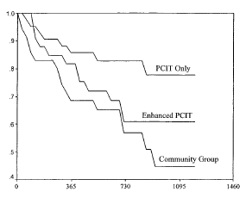
…and lowers CM re-abuse risk up to 3 years after treatment
19% PCIT families re-abused
49% Control group families (SAU) re-abused
Cumulative Survival
Physical Abuse Survival Time in Days
Med = 850 days post-PCIT
Chaffin et al. 2004
Notes:
Chaffin et al (2004) compared traditional parenting services in the community – a 6-week orientation group followed by parenting class to a 6-week motivational group followed by PCIT for physically abusive parents in the child welfare system. (Chaffin, et al., 2004). This was a randomized controlled trial with 111 families.

Slide 17
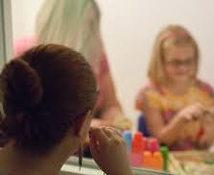


Why PCIT for Child Welfare Involved Families?
Parents practice new skills during therapy sessions^{1,2}
    Warm, responsive caregiving; following child’s lead in play
    Positive discipline/limit-setting training
Therapists provide live (real-time) coaching to parents
    Provide in-vivo social regulation / scaffolding³
    Gently block negative behaviors, coach positive PRIDE skills use
      Positive caregiver-child interactions become self-sustaining over time?
      Parents’ experiences with their child become more enjoyable and rewarding?
¹Kaminski et al 2008; ²Hakman et al 2009; ³Skowron & Funderburk, 2022
Notes:
In vivo coaching may function to
1. interrupt maladaptive / coercive caregiver-child processes, and build Mutually positive & rewarding parent-child interactions
2. Improved parent self-regulation (emotion regulation & self control)
allows parent to maintain lengthier periods of positive interaction and use of safe, effective limit-setting
4. may support softening of harsh social cognitions about self / child
decouple maladaptive linkages between parent physiology and behavior??

Slide 18
PCIT: 1. Child Directed Interaction
  Parents learn
    To follow their child’s lead in the play
    PRIDE skills: Specific, positive parenting skills
      (labelled) Praise
      Reflections
      Imitation
      (behavior) Descriptions
      Enjoyment
    In-session skills practice with real-time therapist support
    “Special Time” home practice (5’ daily)
Notes:
Praise. Parents provide specific praise for a child’s appropriate behavior—for example, telling them, “good job cleaning up your crayons”—to help encourage the behavior and make the child feel good about his or her relationship with the parent.
• Reflection. Parents repeat and build upon what the child says to show that they are listening and to encourage improved communication.
• Imitation. Parents do the same thing that the child is doing, which shows approval and helps teach the child how to play with others.
• Behavioral Description. Parents describe the child’s activity (e.g., “You’re building a tower with blocks”) to demonstrate interest and build vocabulary.
• Enjoyment. Parents are enthusiastic and show excitement about what the child is doing.

Slide 19
PCIT: 2. Parent Directed Interaction
  Parents learn
    Safe, effective limit-setting & positive discipline practices
      Using direct commands:
        Positively-stated
        Developmentally-appropriate
        Possible to obey
        One instruction at a time
      Appropriate follow-through:
        Praise for following instruction
        Brief time-out from positive reinforcement for non-comply
  In-session skills practice with intensive therapist support
Notes:
To reverse coercive patterns
home practice follows skill development in-session

Slide 20
Coaching Alternative
Parenting Strategies (CAPS)
The CAPS Project
randomized clinical trial of PCIT
N = 204 child welfare families
Notes:
Note other RCTs of PCIT with CW families (Chaffin et al: Oklahoma; Thomas and Zimmer-Gembeck in NSW, AU), and # other quasi-experimental studies – PCIT in single group pre-post design (UCDavis Timmer); also emerging work in DV (Amy Herschell) and foster fams (Jason Mersky)

Slide 21
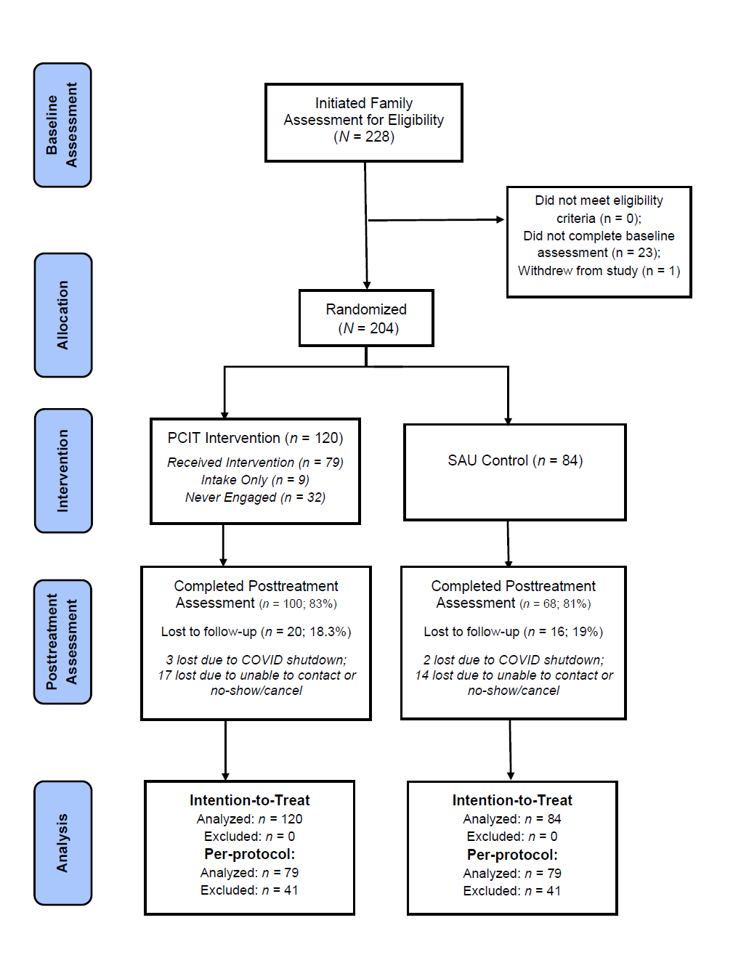

N = 204 child welfare families
Randomized to PCIT or SAU control
Parents
M = 32 yrs. old
30% racial/ethnically diverse
73.5% experienced 4+ ACEs
Children
3-7 yrs. old; 54% boys
Households
Med. Income: $14,400
Below poverty line: 79% families
Notes:
Randomized Clinical Trial
Comparison group = DHS services-as-usual condition
Highlight sections as they are presented
ACEs M=5.2 (SD=2.7);
No differences across conditions on sociodemographics or parent outcome variables, except:
More married/partnered parents in PCIT group (38%) than control (24%)
Only 1/3 study parents reported elevated EBCI Intensity scores (T = 65+)
1 in 5 depressive syms; 1 in 4 anxiety syms

Slide 22

PCIT improves positive parenting skills (ITT & per-protocol)
**

Slide 23

PCIT improves positive parenting skills (ITT & per-protocol)
**
**
**

Slide 24

PCIT reduces negative parenting during child-led play
# Behaviors (5’ child-led play)
Skowron et al., 2024, JCCP
Notes:
ITT & per-protocol

Slide 25
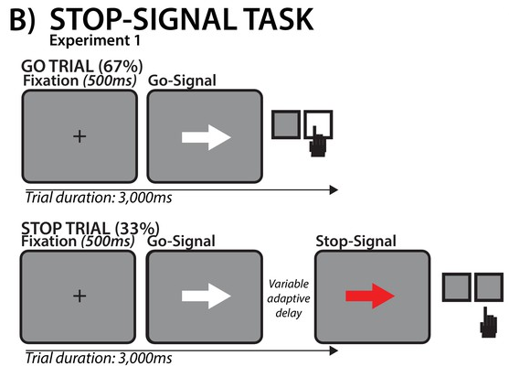



PCIT Strengthens CW Parents’ Self-Regulation Skills
SSRT = Stop signal reaction time
Faster → better inhibitory control
Trial duration: 1,000ms
Trial duration: 1,000ms
Notes:
The stop-signal reaction time (SSRT) task is well established as a paradigm for measuring response inhibition and volitional control
Behavioral stopping / inhibiting – self-control
Specific underlying neural networks engaged by the task
Primary measure of interest was the stop signal reaction time (SSRT), a measure indicative of the inhibitory control process
Lower values indicative of better inhibitory control
Calculated from distribution of response times for go trials (GoRT), the success rate on the stop trials, and the mean stop-signal delay (SSD)
For example, if the success rate is about 50% then the SSRT equals the GoRT at the 50% point of the distribution of GoRTs minus the mean SSD

Slide 26

PCIT Strengthens Parents’ Inhibitory Control
Stop Signal Reaction Time (ms)
Faster SST stopping scores = better inhibitory control
Notes:
Primary measure of interest was the stop signal reaction time (SSRT), a measure indicative of the inhibitory control process
Lower values indicative of better inhibitory control
Calculated from distribution of response times for go trials (GoRT), the success rate on the stop trials, and the mean stop-signal delay (SSD)
For example, if the success rate is about 50% then the SSRT equals the GoRT at the 50% point of the distribution of GoRTs minus the mean SSD

Slide 27

PCIT strengthens CW parents’ emotion regulation (BRIEF-A)
BRIEF-A Emotional Control Problems
(T-scores)
Skowron et al., 2024, JCCP
Notes:
Assesses adult executive functions / self-regulation (75 items, about 10’ to complete; rated on 3-point scale (0 never; 1 sometimes; 2 often) Standardized t scores M = 50, SD = 10)

Slide 28


During Clean-Up: PCIT increases positive parenting skills use, when parents aren’t giving commands
Notes:
new finding → during child compliance exchanges when parents given direction / guidance to children, found PCIT → parents increases in their positive PRIDE skills use in between compliance interactions
Flexible shifting between giving commands, following through, and return to PRIDE skills

Slide 29
Disruptive Child Behavior Problems: PCIT reduces ECBI Intensity Scores in CW children
Skowron et al., 2024, JCCP
Notes:
PCIT significantly reduces ECBI behavior problems → intensity and problem # scores

Slide 30
Disruptive Child Behavior: PCIT reduces ECBI Problem Scores in CW children
Skowron et al., 2024, JCCP
Notes:
PCIT significantly reduces ECBI behavior problems → problem # scores

Slide 31


During Clean-Up: Doesn’t change % effective parent commands
Notes:
PCIT does significantly reduce number of indirect commands given in clean-up, relative to SAU control group parents

Slide 32
During Clean-Up: No main effects on child compliance
Skowron et al., 2023
Notes:
PCIT no sign effect on child compliance…

Slide 33
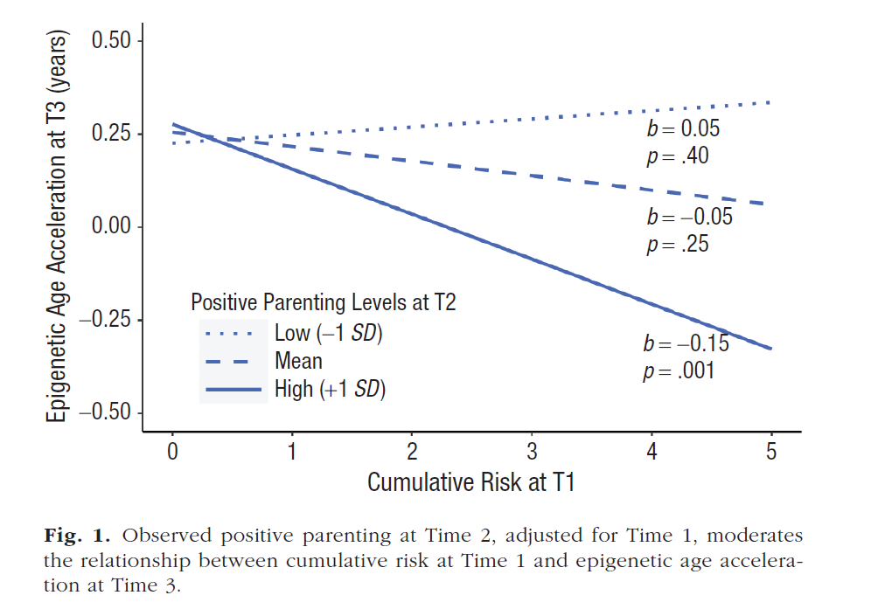
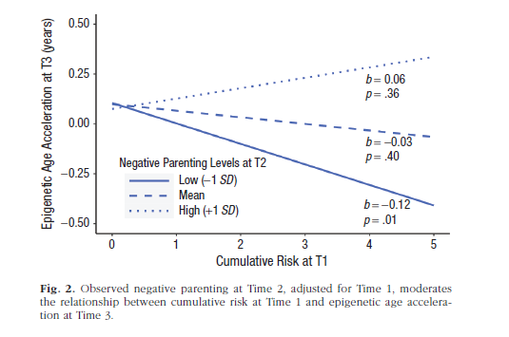
Positive Parenting Gains → Child outcomes: Epigenetic aging(PED-be)
Sullivan, Bozack, Cardenas, Comer, Bagner, Forehand, & Parent (2023). Psychological Science
Notes:
This study → secondary analysis of 71 children (ACEs exposures & develop. disabilities) whose families participated in a randomized clinical trial and received either internet-based PCIT or referrals as usual -- At all home visits, saliva DNA samples were collected from children using Oragene kits
sought to address the question, “Does an evidence-based parenting intervention alleviate impact of cumulative risk on epigenetic aging.
Greater epigenetic age acceleration has been linked with exposure to harsh parenting and experiences of threat, poverty, minoritized racial identity, parental psychopathology and other disruptions to caregiving, and simultaneous increases in DNAm-derived markers of inflammation.
Results from this study – no stat sign intervention effects…however, regardless of intervention status, suggest that improvements in parenting may attenuate the impact of adversity exposure on child development, specifically on biomarkers of aging such as epigenetic age acceleration.

Slide 34
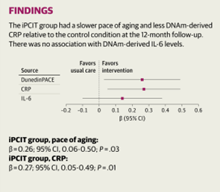
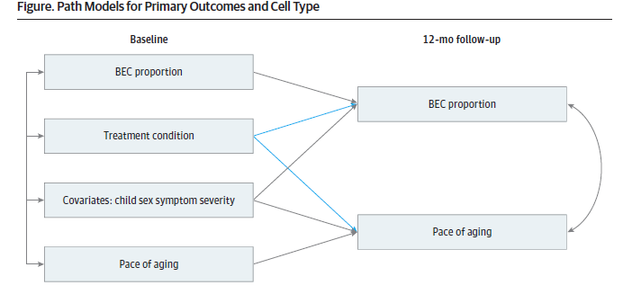
PCIT → Child Outcomes: Epigenetic aging & Inflammation
Merrill, Hogan, Bozack, Cardenas, Comer, Bagner, Highlander, & Parent (2024). JAMA Network Open
Notes:
This study addressed the question, “Does an evidence-based parenting intervention alleviate salivary DNA methylation (DNAm)–derived biomarkers of stress in children with developmental delays? biomarkers of inflammation (CRP) and epigenetic aging have been also been independently associated with harsh parenting, family stress, and later psychopathology.
secondary analysis of 71 children (with developmental delays) whose families participated in a randomized clinical trial and received either internet-based PCIT or referrals as usual,
there was a significantly slower pace of aging and reduced DNAm-derived C-reactive protein among children who received the intervention, but DNAm-derived interleukin-6 did not differ; these findings persisted when accounting for cell type proportion (Buccal epithelial cell proportion) and covariates (separate models were run for pace of aging) .
findings suggest that parenting interventions can modify stress-related biological aging and inflammation, supporting their potential to enhance the long-term health of children with developmental delays.
Results may support policy and clinical guidelines. In other words, suggests that improvements in
parenting, over time, translate to physiological changes in young children. Promote positive caregiving practices === as a primary target of intervention.
NOTE in the US, most insurance requires evidence of clinically elevated behavioral health problems before access is granted to parenting interventions.
Because accelerated epigenetic age is linked not only to psychological conditions but also to many costly physical health conditions, broadening access to these services may improve child outcomes.
More details: The positive impact of iPCIT on the rate of epigenetic aging suggests parenting interventions
may have the potential to modify aspects of stress-related biological embedding. The pace of aging,
by design, is rooted in the dynamics of health and phenotypes supporting successful biological aging
processes. In a previous study, we found no main treatment association with a different
epigenetic age marker (PedBE), only an association of parenting among those relatively higher in
baseline adversity.21 As such, it may be that because DunedinPACE encompassed multiple biological
domains of health in its development, this measure may reflect systemic biological effects on
processes related to stress and coping.
CRP is an inflammatory response protein believed to elevate in the context of chronic stress. Recent research indicates DNAm-derived CRP is longitudinally stable and may be more reflective of sustained inflammation than serum CRP, especially regarding associations with neural outcomes. The observed decrease in DNAm-derived CRP for participants who received iPCIT consistent with literature linking psychosocial stressors with CRP inflammatory responses -- these findings potential evidence for sensitivity within a more systemic biological response to stressors. Parenting interventions, by fostering supportive and nurturing environments, might mitigate chronic stressors that contribute to
elevated CRP levels. (IL-6 → NS, more complex role in pro- and anti-inflammatory processes? Further upstream…?)
CAPS Study Metabolomics Analyses – our similar findings, small n, pre-review…

Slide 35
Who benefits more…and less from PCIT?
Individual differences → response to PCIT
Penn State Child Maltreatment Solutions Network Conference: Biological Embedding of Caregiving Adversity (11/15/2024)
Notes:
A good news and bad news story to date…
Skoranski^, A., Skowron, E.A., Scholtes, C.M., Nekkanti, A.K., Lyons, E.L., & DeGarmo, D.S. (2021). PCIT engagement and persistence among child welfare-involved families: Associations with harsh parenting, physiological reactivity, and social cognitive processes at intake. Development & Psychopathology. 1–18. PMC8464633. DOI: 10.1017/S0954579421000031

Slide 36




Differential Response: Engage & Persist in PCIT (child welfare families)
CW parents who declined PCIT:
  more negative parenting at intake
Persistence in Child Directed Interaction Phase:
  greater physiological calm (RSA) during social engagement task
  Less tendency to misinterpret neutral faces as angry
Persistence in Parent Directed Interaction Phase:
  physiological calm (greater RSA) during social engagement
  positive child attributions
Skoranski et al., 2021 Development & Psychopathology
Notes:
potentially modifiable barriers to treatment engagement among child welfare-involved parents
Of note, parents who declined to engage in PCIT at all → more negative parenting at intake. This implies that parents who have the most to benefit from PCIT (i.e., those with higher levels of negative parenting and thus greater potential for change) are those who are also least inclined to voluntarily engage in treatment.
participation in PCIT has been shown to lead to marked declines in negative parenting (Hakman et al., 2009). As such, the current findings lend support for policies that mandate engagement in PCIT for child welfare-involved families
Once engaged in treatment, several factors were shown to promote family persistence in PCIT. Evidence from this study suggests that a pattern of parasympathetic nervous system responding (i.e., greater RSA activation during mutually positive dyadic interactions and RSA withdrawal during a challenging dyadic toy clean up task) and less tendency to misinterpret neutral facial images as angry both lower the risk for mid-treatment dropout. As such, interventions that calm threat sensitivity and support physiological responses that help scaffold positive parenting could be useful to promote continued engagement.
parents who hold more positive attributions about their children and display physiological calm (i.e., RSA increases) during mutually positive social engagement with their child are also more likely to persist in PCIT through PDI phase sessions.

Slide 37
Social Engagement Task
Wismer Fries, Ziegler, Kurian, Jacoris, & Pollak (2005) PNAS
Notes:
Dyads then complete the Social Engagement task (34) (SET)
during which the child and adult are seated in close physical
proximity while completing three reciprocal activities: (1) gently
pointing to the other’s facial features (i.e., hair, chin, nose, and
ears); (2) counting each other’s fingers; and (3) whispering a
story in each other’s ear (see Figure 3). Children complete the
task twice: once with their parent and once with a female
research assistant. Each activity is presented for a fixed time
interval and the story told by the research assistant is the same
with all families. Activity order remains consistent across dyads,
whereas the interactive partner condition (i.e., parent or research asst changes order)

Slide 38

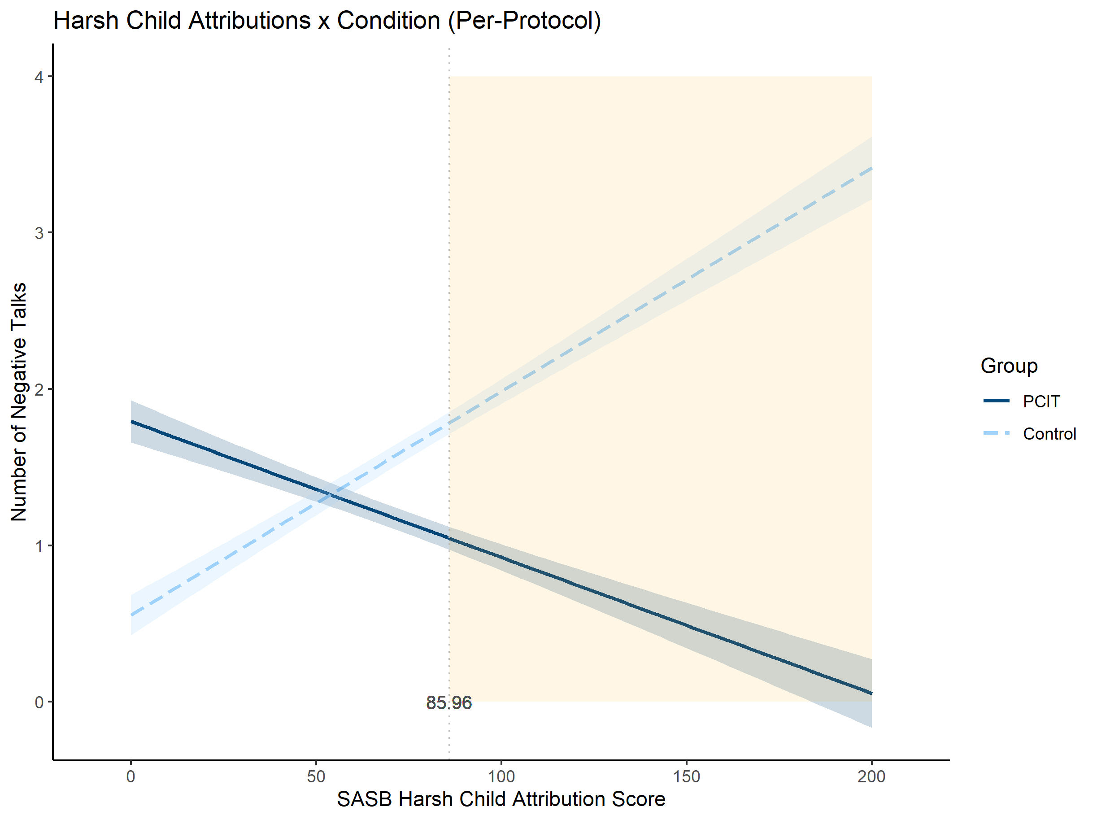
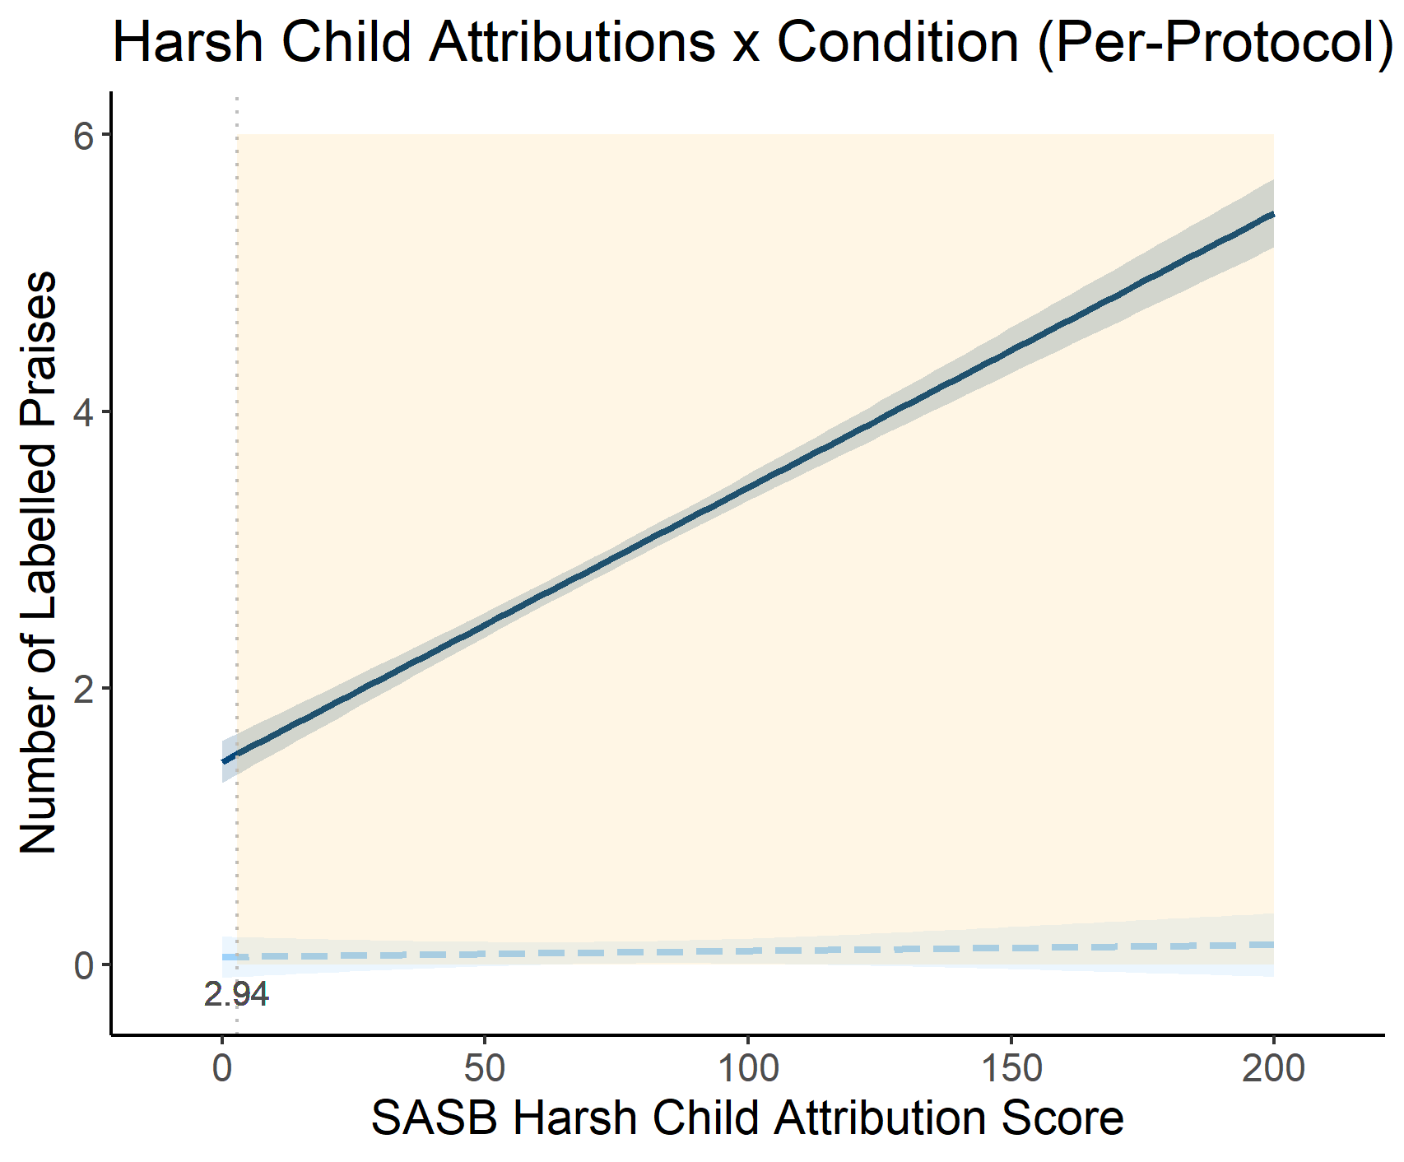
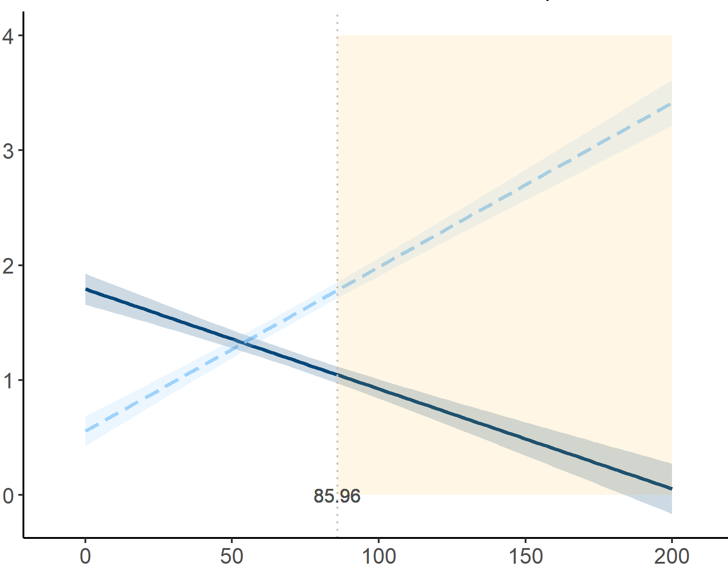
Differential response: Parents with harsh, negative child attributions benefit more from PCIT
parenting skills outcomes
Group
# DPICS Labeled Praises
# DPICS Negative Talks
SASB: Harsh Child Attributions Scores
Skowron et al., 2024, JCCP
Notes:
Moderation: “Whom” does the intervention work for; “Who” responds more/less to the intervention.
Figure 3. Interactions between condition and pre-treatment variables in the per-protocol sample are presented. Vertical dotted lines denote the value of the moderator (X-axis) at which the interaction is significant. Shaded areas mark the regions of significance.

Slide 39
Dynamic associations between caregiver physiology & positive parenting at intake ➔ Benefit Less from PCIT Intervention
Therapist-rated ever-achieving CDI mastery
Positive (PRIDE) parenting behaviors
↓ p = .02
↓ p = .07
Coders-rated % of sessions mastering PRIDE skills
+
-
Cardiac arousal
(lower IBI)
↓ p = .04
Pre-post gains in PRIDE skills during child-led play
Pre-intervention
assessment
Randomization
Intake
CDI sessions
PDI sessions
Post-intervention
assessment
Zhang, Gatzke-Kopp, & Skowron, under review
Notes:
Both parameters indicating the bidirectional, dynamic associations between physiological arousal and positive parenting at pre-intervention, varied by later treatment process and outcomes
Interpretation: parents who showed “coupling” associations between physio arousal and positive parenting were less likely to achieve CDI skills mastery (positive, responsive parenting behaviors in situations where they need to warmly follow child’s lead) in 1st phase of tx and at post-treatment outcome.
In case anyone asks – the Wave 1 dynamics were NOT associated with the average frequency of positive parenting skills at Wave 1, but it predicted post-intervention frequency after controlling for Wave 1 frequency (thus reflecting pre-post changes)
Might be worth noting that we’re analyzing a relatively small sample here (n = 79) that had any CDI treatment, so power could be an issue

Slide 40
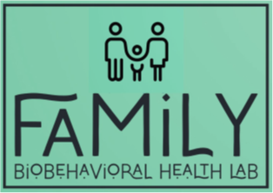

Summary
Caregiving Risk…
    physiological arousal drives harsh, control parenting
    child trusting/relying (bids for support) drive physiological arousal in physically abusive mothers
    *mothers who achieve positive (behavioral) synchrony with their preschooler display more dynamic RSA response
    maladaptive caregiving processes
      parent ruptures & child repairs
      unpredictable responding to positive/neutral child behavior (coercive process) & reinforcing negative child behavior
Benefits of Parent-Child Interaction Therapy (PCIT) for child welfare-involved families
    Parenting: behavior & self-regulation skills
    Children: behavior
    NO main EFFECTS: on caregiver or child physiology outcomes
Specificity of PCIT’s effectiveness (i.e., moderators)
    Greatest parenting skills gains achieved by parents with harsh, negative child attributions
    Risk for drop-out ← caregiver physiological arousal during mutual positive caregiving interactions
    Maladaptive physio-behave coupling → limits parenting skills gains
Notes:
Invisible drivers: include chronic stress, self-regulation deficits, MH and SA problems
Warm parenting…Associated with ↑ arousal in abusive mothers
Calms a neglecting mother
Preceded by modest increases in arousal in non-maltreating mothers
Children’s trusting / relying behaviors (prosocial compliance)
Heightens physio arousal in abusive mothers
Non-maltreated children: their trusting/relying behaviors → no impact mother physiology
Interpreted in light of maternal intra-individual results it suggests that CM moms are becoming more aroused, more emotionally dysregulated in response to age-appropriate, prosocial child behavior (alternately, are CM moms just ‘working harder’ in response to child trusting and relying, whereas non-CM moms don’t need to do so?
Signify ↑ parent dysregulation in face of developmentally-appropriate child behavior?
Evidence that prosocial caregiving relationships are simply more difficult in some parents?
Other?

Slide 41

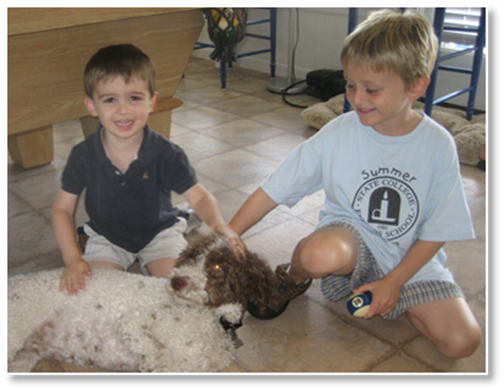










Thank You
Funders
National Institutes of Health (NIMH & NIDA)
University of Oregon
Students, Staff, & Post-Docs
Kadie Dubow, Emily Dunning, Ryan Giuliano, Felicia Gutierrez, Rose Jeffries, Kandyce Kelly, Maddie Kelm, Emma Lyons, Janet Morrison, Akhila Nekkanti, Lisa Shimomaeda, Carrie Sholtes, Camy Sibley, Amanda Skoranski, Jessica Wells, Kyndl Woodlee, Larisa Williamson, Keegan Alvarado, Kate Kwasneski, Alexis Rock, Adon Rosen, Julia Ruggiero & countless other undergraduate researchers
Collaborators
Ted Beauchaine, David Bard, Dave DeGarmo, Lisa Gatzke-Kopp, Kate Mills, Elizabeth Bard, Vicki Cook, Beverly Funderburk, Alejandra Moreno, Amanda Pollack, Carisa Wilsie

Slide 42
Questions & Discussion
Penn State Child Maltreatment Solutions Network Conference: Biological Embedding of Caregiving Adversity (11/15/2024)
Notes:
Thank yous:
Thank you’s for invitation to speak:
research was funded by the National Institutes of Health through National Institute on Drug Abuse Grant R01-DA036533
Skowron, E. A., Nekkanti, A.K., Skoranski^, A.M., Scholtes, C.M., Mills, K.L., Bard, D., Rock, A., Berkman, E., Bard, E., & Funderburk, B. W. (2024). Randomized trial of parent–child interaction therapy improves child-welfare parents’ behavior, self-regulation, and self-perceptions. Journal of Consulting and Clinical Psychology, 92(2), 75–92. https://doi.org/10.1037/ccp0000859
Zhang^, X., Gatzke-Kopp, L. M., & Skowron, E. A. (2023). Dynamic regulatory processes among child welfare parents: Temporal associations between physiology and parenting behavior. Development and psychopathology, 1–16. https://doi.org/10.1017/S0954579423000949 (and the ‘in prep’ paper…)
Lyons^, E.R., Nekkanti^, A.K., Funderburk, B.W., & Skowron, E.A. (2022). Parent-Child Interaction Therapy supports healthy eating behavior in child welfare-involved children. International Journal of Environmental Research and Public Health, special issue “Parent-Child Interaction Therapy: Advances toward Health Equity,” 19, 10535. doi.org/10.3390/ijerph191710535
Skowron, E. A., & Funderburk, B. W. (2022). In vivo social regulation of high-risk parenting: A conceptual model of Parent-Child Interaction Therapy for child maltreatment prevention. Children and Youth Services Review, 136, 106391. PMC8881007 doi.org/10.1016/j.childyouth.2022.106391.
Skoranski^, A., Skowron, E.A., Scholtes, C.M., Nekkanti, A.K., Lyons, E.L., & DeGarmo, D.S. (2021). PCIT engagement and persistence among child welfare-involved families: Associations with harsh parenting, physiological reactivity, and social cognitive processes at intake. Development & Psychopathology. 1–18. PMC8464633. DOI: 10.1017/S0954579421000031

